Slide 1



Electric Current Notes
Electric current is related to the voltage that produces it, and the resistance that opposes it.

Slide 2
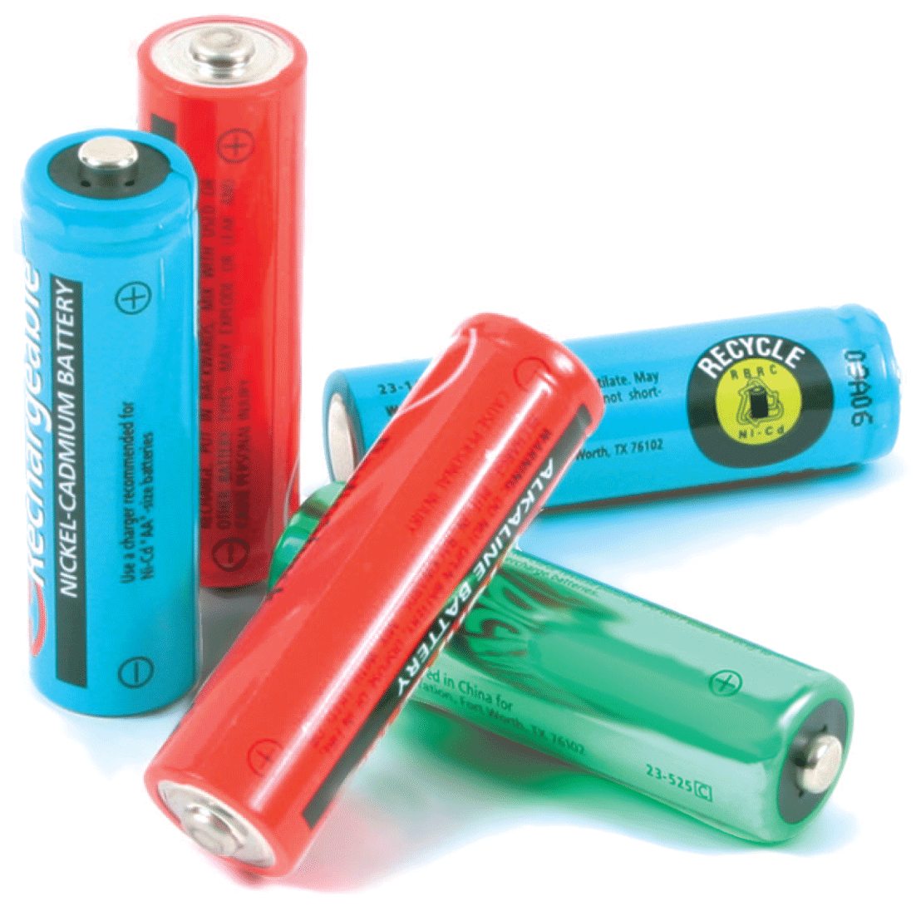
Key Terms
Voltage produces a flow of charge, or current, within a conductor.
The flow is restrained by the resistance it encounters.
The rate at which energy is transferred by electric current is power.

Slide 3

Flow of Charge
When the ends of an electric conductor are at different electric potentials, charge flows from one end to the other.

Slide 4
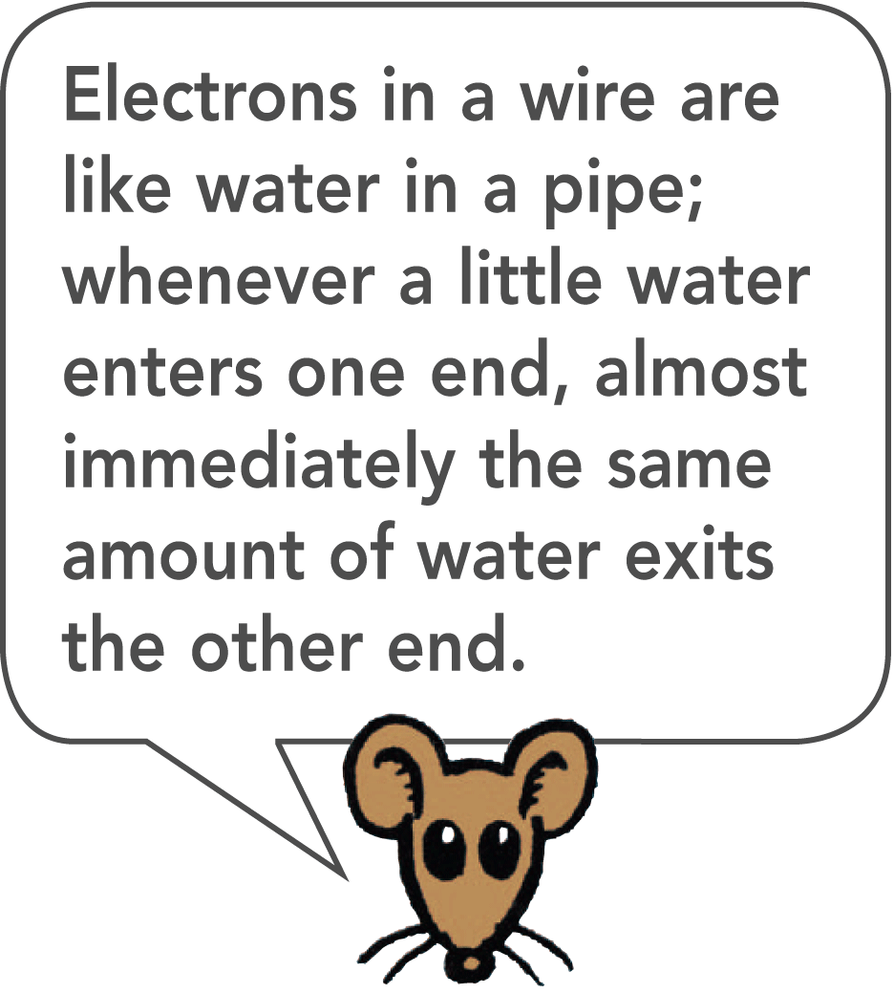
Flow of Charge
Charge flows in a similar way. Charge flows when there is a potential difference, or difference in potential (voltage), between the ends of a conductor. The flow continues until both ends reach the same potential.
When there is no potential difference, there is no longer a flow of charge through the conductor.
To attain a sustained flow of charge in a conductor, one end must remain at a higher potential than the other.

Slide 5
Electric Current
A current-carrying wire has a net electric charge of zero.

Slide 6
Electric Current
Electric current is the flow of electric charge.
In solid conductors, electrons carry the charge through the circuit because they are free to move throughout the atomic network.
These electrons are called conduction electrons.
Protons are bound inside atomic nuclei, locked in fixed positions.
In fluids, such as the electrolyte in a car battery, positive and negative ions as well as electrons may flow.

Slide 7
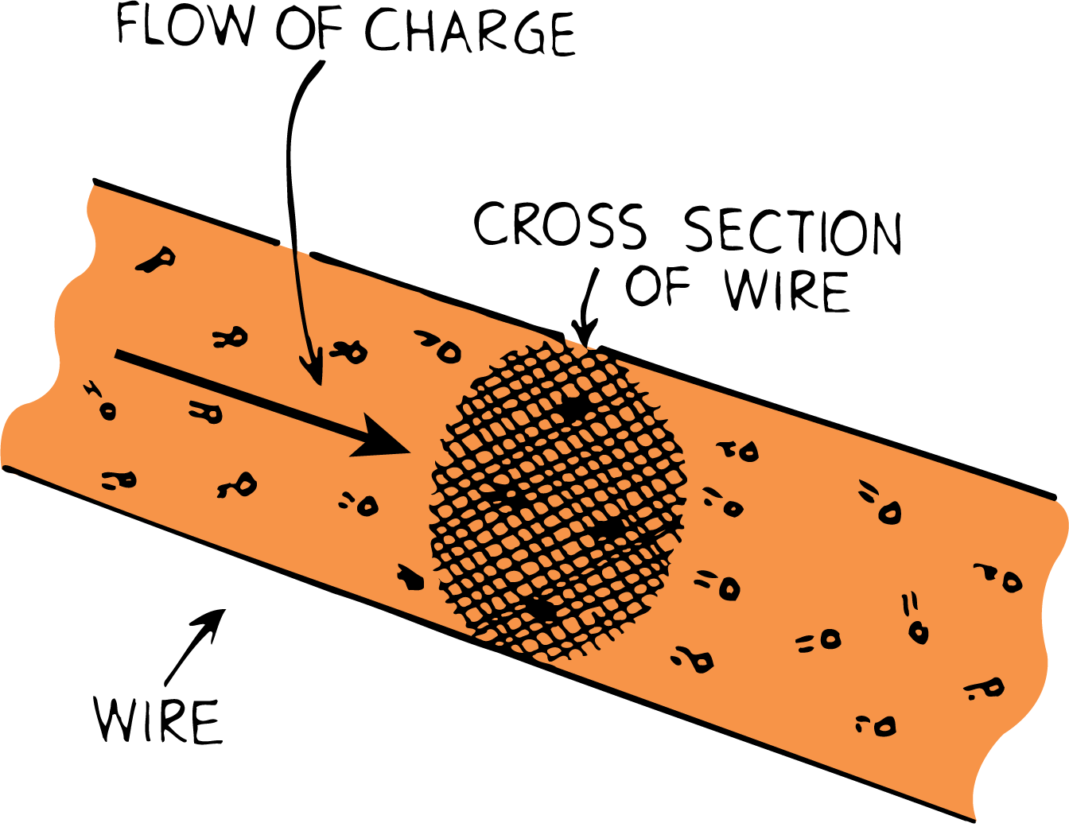
Electric Current
Measuring Current
Electric current is measured in amperes, symbol A.
An ampere is the flow of 1 coulomb of charge per second.
When the flow of charge past any cross section is 1 coulomb per second, the current is 1 ampere.

Slide 8
Voltage Sources
Voltage sources such as batteries and generators supply energy that allows charges to move steadily.
Charges do not flow unless there is a potential difference.
Something that provides a potential difference is known as a voltage source.
Batteries and generators are capable of maintaining a continuous flow of electrons.

Slide 9
Voltage Sources
Steady Voltage Sources
In a battery, a chemical reaction releases electrical energy.
Generators—such as the alternators in automobiles—convert mechanical energy to electrical energy.
The electrical potential energy produced is available at the terminals of the battery or generator.

Slide 10
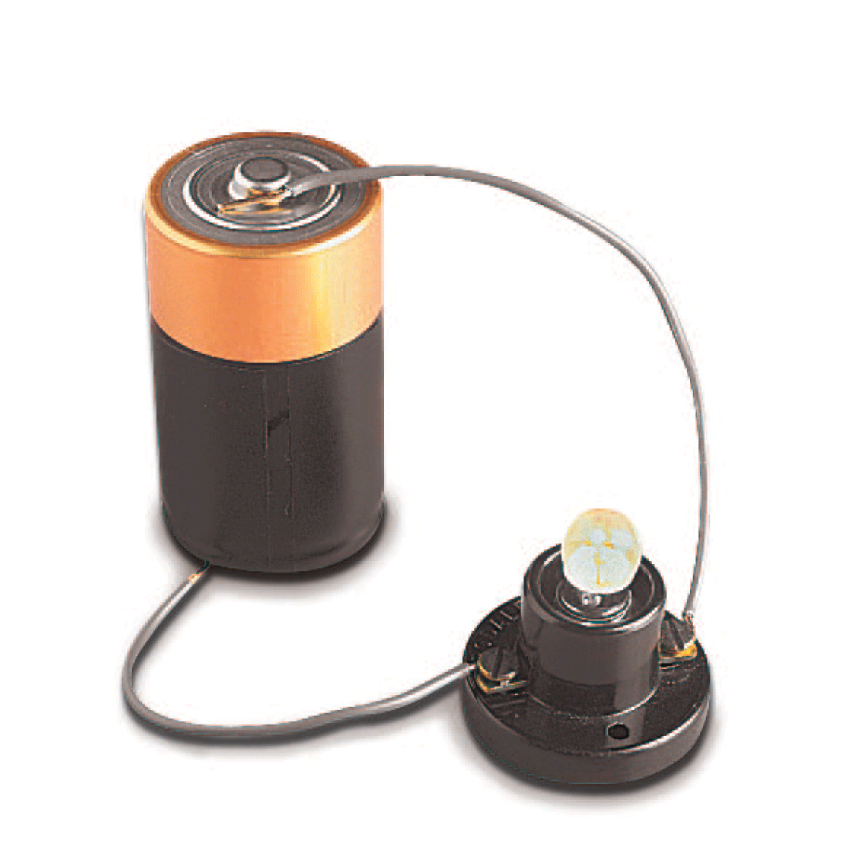
Voltage Sources
The potential energy per coulomb of charge available to electrons moving between terminals is the voltage.
The voltage provides the “electric pressure” to move electrons between the terminals in a circuit.

Slide 11
Voltage Sources
Power utilities use electric generators to provide the 120 volts delivered to home outlets.
The alternating potential difference between the two holes in the outlet averages 120 volts.
When the prongs of a plug are inserted into the outlet, an average electric “pressure” of 120 volts is placed across the circuit.
This means that 120 joules of energy is supplied to each coulomb of charge that is made to flow in the circuit.

Slide 12
Voltage Sources
Distinguishing Between Current and Voltage
There is often some confusion between charge flowing through a circuit and voltage being impressed across a circuit.

Slide 13
Voltage Sources
Consider a long pipe filled with water.
Water will flow through the pipe if there is a difference in pressure across the pipe or between its ends.
Water flows from high pressure to low pressure.
Similarly, charges flow through a circuit because of an applied voltage across the circuit.
You don’t say that voltage flows through a circuit.
Voltage doesn’t go anywhere, for it is the charges that move.
Voltage causes current.

Slide 14
Electric Resistance
The resistance of a wire depends on the conductivity of the material used in the wire (that is, how well it conducts) and also on the thickness and length of the wire.

Slide 15
Electric Resistance
The amount of charge that flows in a circuit depends on the voltage provided by the voltage source.
The current also depends on the resistance that the conductor offers to the flow of charge—the electric resistance.
This is similar to the rate of water flow in a pipe, which depends on the pressure difference and on the resistance of the pipe.

Slide 16
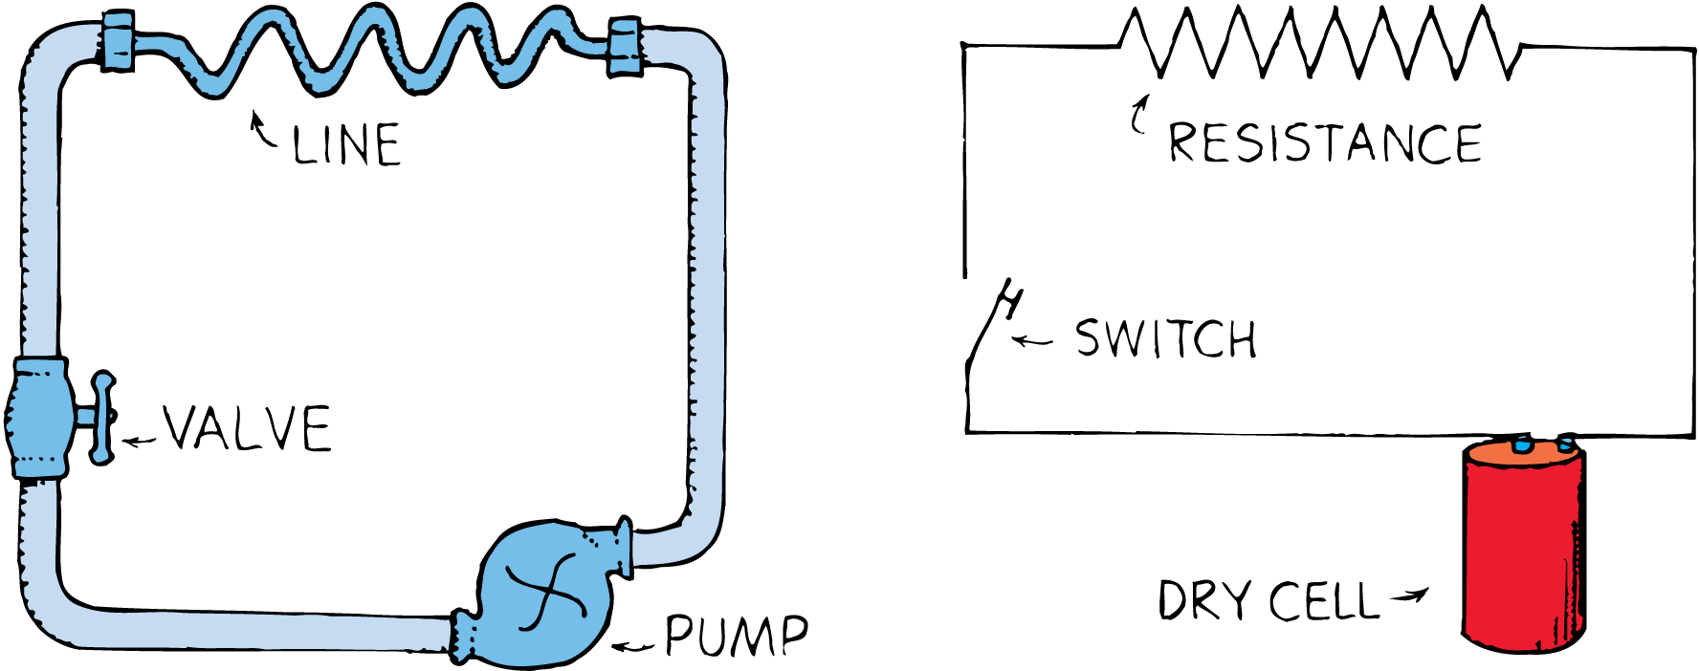
Electric Resistance
A simple hydraulic circuit is analogous to an electric circuit.

Slide 17
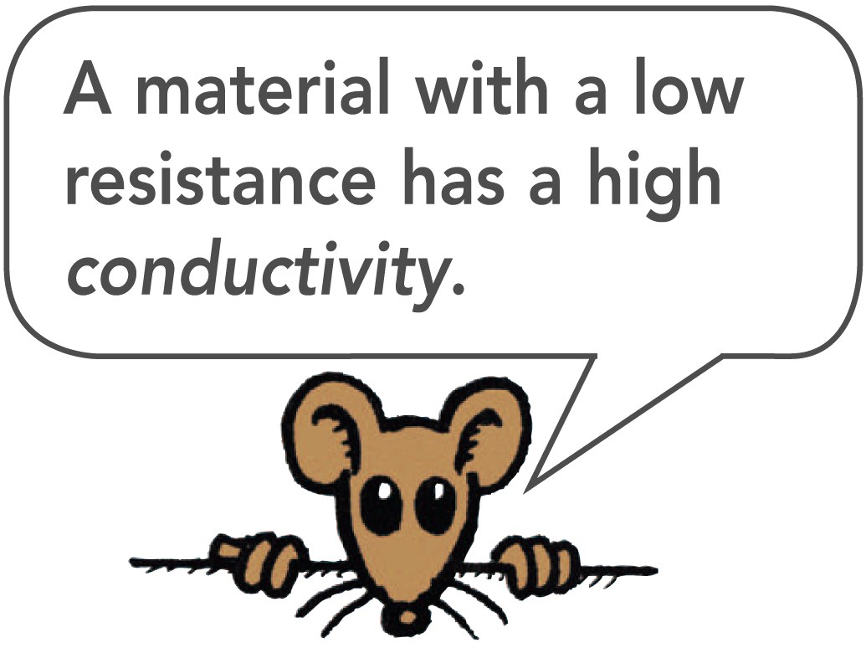
Electric Resistance
The resistance of a wire depends on the conductivity of the material in the wire and on the thickness and length of the wire.
Thick wires have less resistance than thin wires.
Longer wires have more resistance than short wires.
Electric resistance also depends on temperature. For most conductors, increased temperature means increased resistance.

Slide 18
Ohm’s Law
Ohm’s law states that the current in a circuit is directly proportional to the voltage impressed across the circuit, and is inversely proportional to the resistance of the circuit.

Slide 19
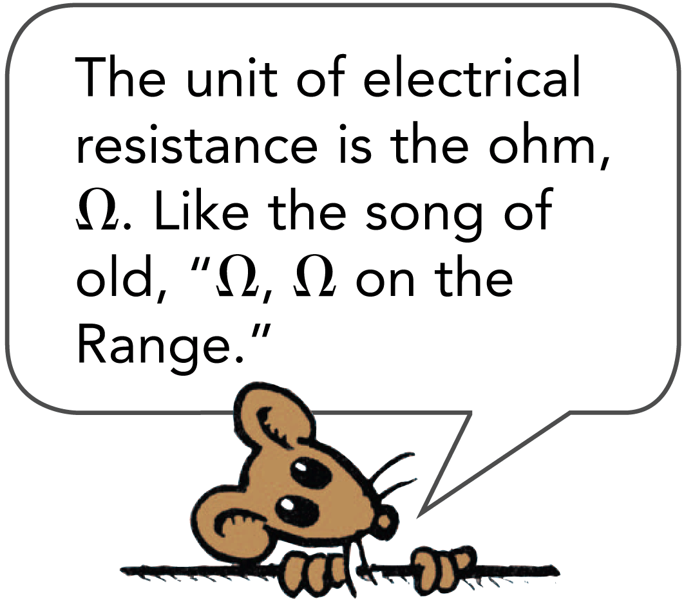
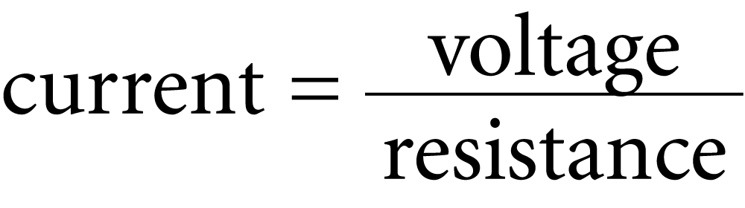
Ohm’s Law
Electric resistance is measured in units called ohms.
Georg Simon Ohm, a German physicist, tested wires in circuits to see what effect the resistance of the wire had on the current.
The relationship among voltage, current, and resistance is called Ohm’s law.

Slide 20
Ohm’s Law
For a given circuit of constant resistance, current and voltage are proportional.
Twice the current flows through a circuit for twice the voltage across the circuit. The greater the voltage, the greater the current.
If the resistance is doubled for a circuit, the current will be half what it would be otherwise.

Slide 21
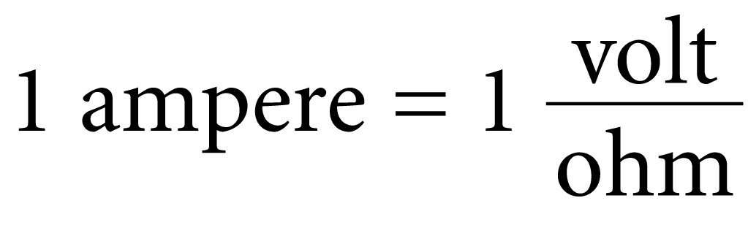
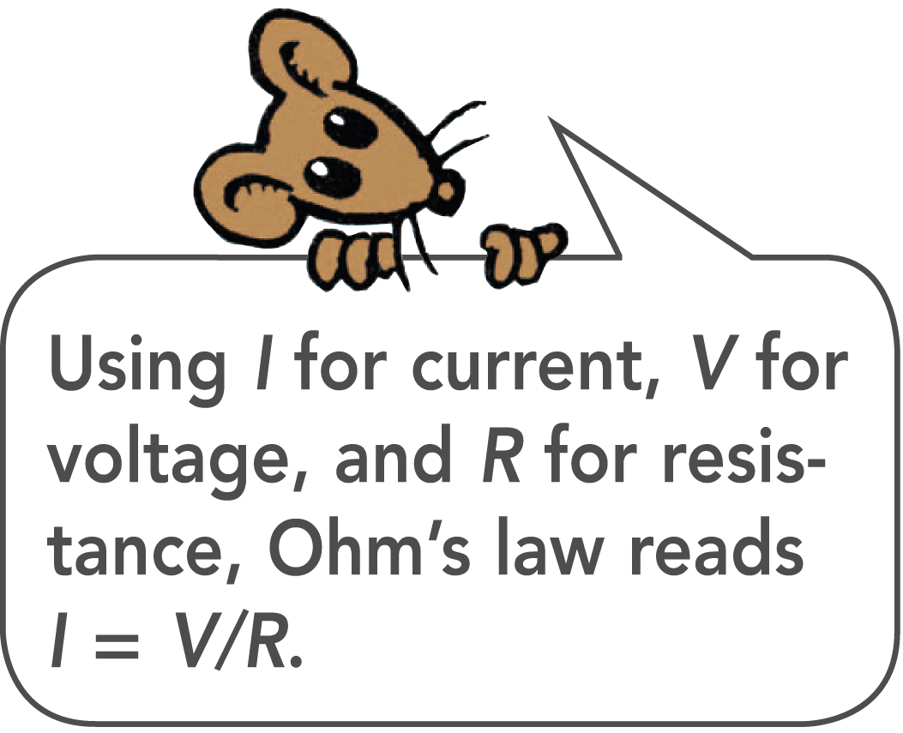
Ohm’s Law
The relationship among the units of measurement is:
A potential difference of 1 volt impressed across a circuit that has a resistance of 1 ohm will produce a current of 1 ampere.
If a voltage of 12 volts is impressed across the same circuit, the current will be 12 amperes.

Slide 22
Ohm’s Law
think!
How much current is drawn by a lamp that has a resistance of 100 ohms when a voltage of 50 volts is impressed across it?

Slide 23
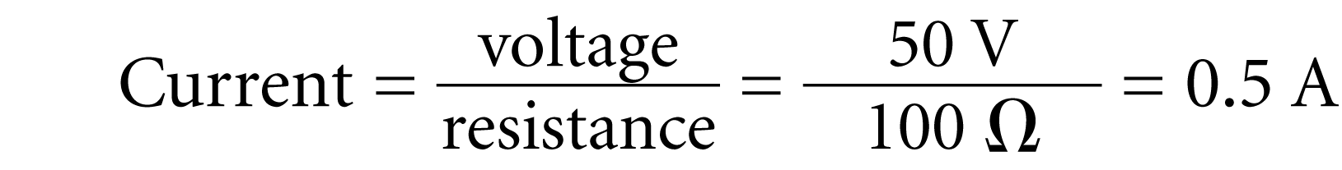
Ohm’s Law
think!
How much current is drawn by a lamp that has a resistance of 100 ohms when a voltage of 50 volts is impressed across it?
Answer:

Slide 24
Direct Current and Alternating Current
Electric current may be DC or AC.

Slide 25
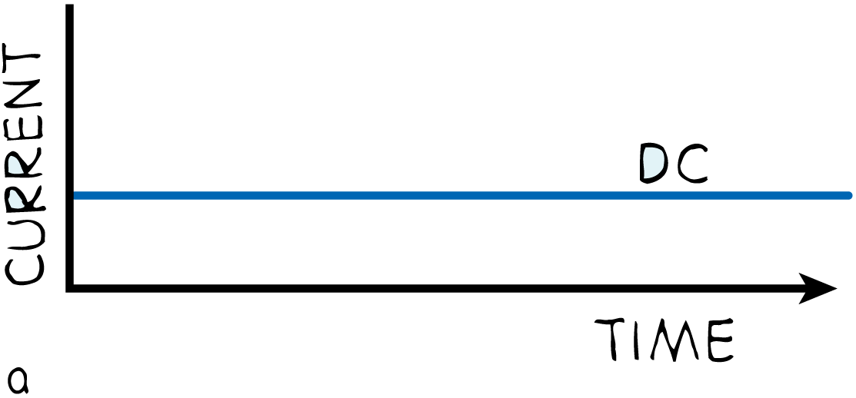
Direct Current and Alternating Current
By DC, we mean direct current, which refers to a flow of charge that always flows in one direction.
A battery produces direct current in a circuit because the terminals of the battery always have the same sign of charge.
Electrons always move through the circuit from the negative terminal toward the positive terminal.
Even if the current moves in unsteady pulses, so long as it moves in one direction only, it is DC.

Slide 26
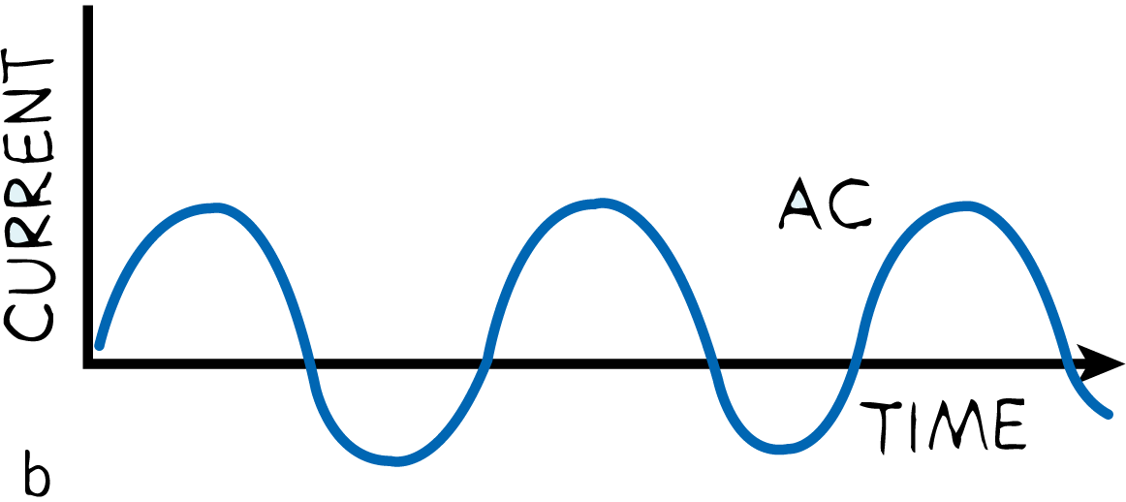
Direct Current and Alternating Current
Alternating current (AC), as the name implies, is electric current that repeatedly reverses direction.
Electrons in the circuit move first in one direction and then in the opposite direction.
They alternate back and forth about relatively fixed positions.
This is accomplished by alternating the polarity of voltage at the generator or other voltage source.

Slide 27
Electric Power
Electric power is equal to the product of current and voltage.

Slide 28
Electric Power
Unless it is in a superconductor, a charge moving in a circuit expends energy.
This may result in heating the circuit or in turning a motor.
Electric power is the rate at which electrical energy is converted into another form such as mechanical energy, heat, or light.

Slide 29
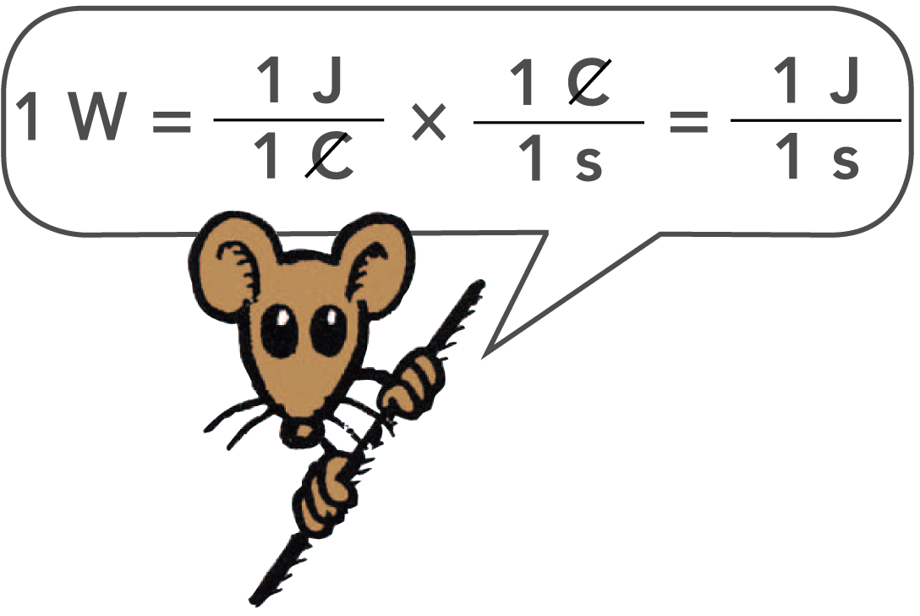
Electric Power
Electric power is equal to the product of current and voltage.
electric power = current × voltage
If the voltage is expressed in volts and the current in amperes, then the power is expressed in watts.
1 watt = (1 ampere) × (1 volt)

Slide 30
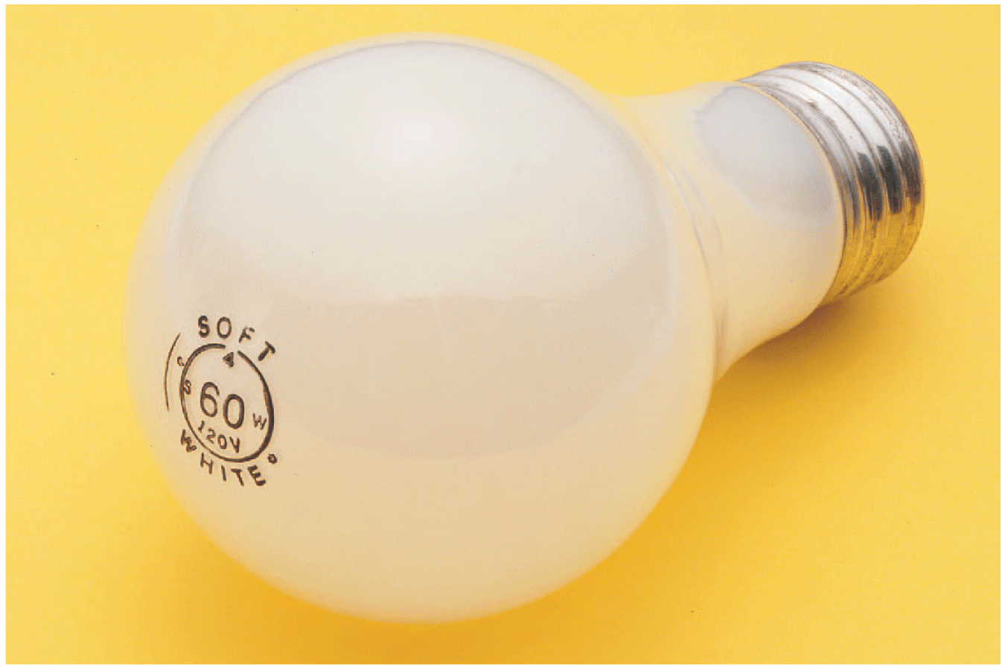
Electric Power
The power and voltage on the light bulb read “60 W 120 V.”
The current that would flow through the bulb is:
I = P/V = (60 W)/(120 V) = 0.5 A.

Slide 31
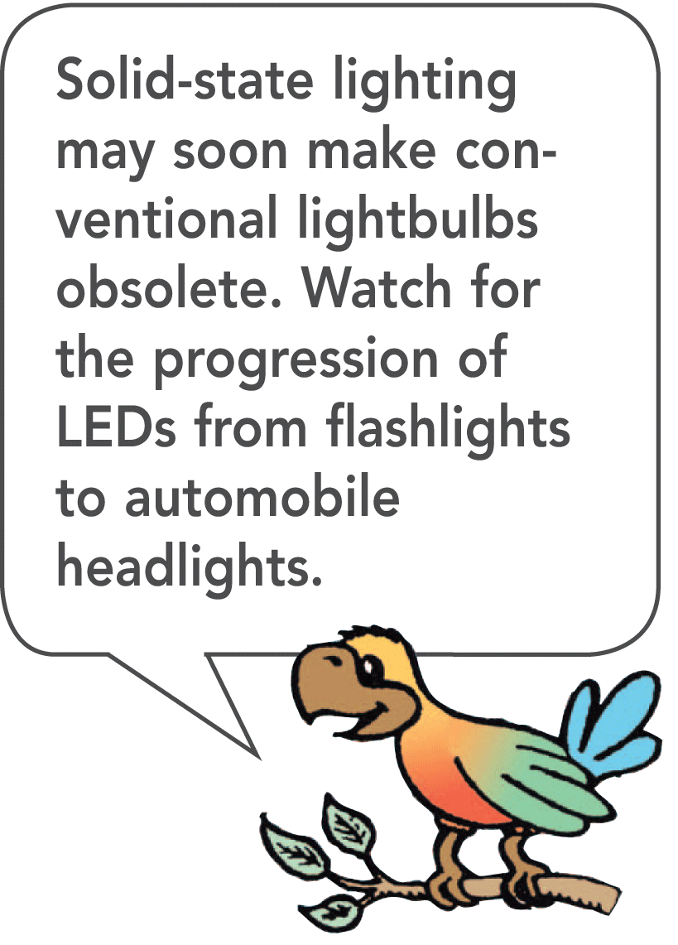
Electric Power
A lamp rated at 120 watts operated on a 120-volt line will draw a current of 1 ampere: 120 watts = (1 ampere) × (120 volts).
A 60-watt lamp draws 0.5 ampere on a 120-volt line.

Slide 32
Electric Power
A kilowatt is 1000 watts, and a kilowatt-hour represents the amount of energy consumed in 1 hour at the rate of 1 kilowatt.
Where electrical energy costs 10 cents per kilowatt-hour, a 100-watt light bulb burns for 10 hours for 10 cents.
A toaster or iron, which draws more current and therefore more power, costs several times as much to operate for the same time.

Slide 33
Electric Power
think!
How much power is used by a calculator that operates on 8 volts and 0.1 ampere? If it is used for one hour, how much energy does it use?

Slide 34
Electric Power
think!
How much power is used by a calculator that operates on 8 volts and 0.1 ampere? If it is used for one hour, how much energy does it use?
Answer: Power = current × voltage = (0.1 A) × (8 V) = 0.8 W. Energy = power × time = (0.8 W) × (1 h) = 0.8 watt-hour, or 0.0008 kilowatt-hour.

Slide 35
Electric Power
think!
Will a 1200-watt hair dryer operate on a 120-volt line if the current is limited to 15 amperes by a safety fuse? Can two hair dryers operate on this line?

Slide 36
Electric Power
think!
Will a 1200-watt hair dryer operate on a 120-volt line if the current is limited to 15 amperes by a safety fuse? Can two hair dryers operate on this line?
Answer: One 1200-W hair dryer can be operated because the circuit can provide (15 A) × (120 V) = 1800 W. But there is inadequate power to operate two hair dryers of combined power 2400 W. In terms of current, (1200 W)/(120 V) = 10 A; so the hair dryer will operate when connected to the circuit. But two hair dryers will require 20 A and will blow the 15-A fuse.

Slide 37
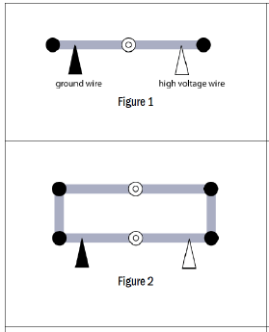
Light Bulb Lab
Single Bulb Circuit
Set up a circuit with your power supply and only one bulb. Turn on Power Supply.
Use Red Voltmeter, record the voltage on each metal connector.

